Slide 1
Pension Management System
Done By:- Vijendra Kumawat
Empid:- 2217547

Slide 2




Table of Contents
Introduction
Functionality
Implemented Methods
Architecture of Application(Spring-Boot Architecture)
Procedure
Dockerization
Steps of Dockerization
Requirements
Advantages
Conclusion

Slide 3
Introduction
The purpose of building this application is to build a system that gives employee or employer various functionality for their pension management system.
This application includes various function like create applicant , check status , check balance ,check application,issue pension ,load pension using spring boot framework.

Slide 4
Functionality
1. Add Pensioner/Employee Records
2. View Employee Records
3. Search Records(by id)
4. Calculate Pension(by their status)

Slide 5
Implemented Methods
Create
Create Applicant
Check
Check Status(by id)
Check
Check Balance(by id)
Check
Check Application(by id)
Issue
Issue Pension
Load
Load Pension

Slide 6
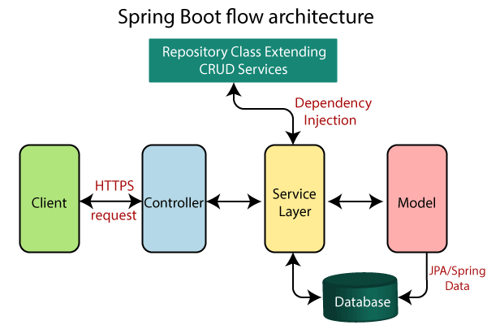

Slide 7
Procedure
Create Application structure using Spring Intillizer by adding requirement,dependency and versions.
Download zip from spring initializer and extract that and open it from IDE.
Write required functionality.
We have to build the application by using maven clean install.
Start mysql image in docker using
Docker-compose -f docker-compose-mysql.yml up -d.
Run the Spring Boot Application.

Slide 8
Continue…
Tomcat server will be started.
Check all functionality from postman.
Check the data in Postman by using url https://localhost: port number/method name.
Now we can perform the actions of methods on the data.

Slide 9

Dockerization
Dockerizing is the process of packing, deploying, and
running applications using Docker containers.

Slide 10
Steps of Dockerization
1. To dockerization we need Dockerfile in our application.
2.After that start docker from docker desktop
3.Run command mvn install dockerfile:build
4.Check docker desktop weather image is created or not
5.Push to docker hub from docker desktop.

Slide 11
System Requirements
Software
Spring-Boot Framework
Necessary dependencies & database
Postman & Docker
Java SDK 11 or above
IDE(Intellij,Eclipse)
Hardware
Windows 10 or above
RAM 8GB

Slide 12
Advantages
Easy to use/User friendly.
Due to database it minimize data redundancy.
Easy to perform operations like add, update, search, delete etc.

Slide 13
Conclusion
This Pension Management System is designed to manage pension activities for both applicants and pension admins. It is beneficial to a pension management organization as well as employee because it is easy to use and user friendly Thus, the basic aim of carrying out this project is to develop a solution that will largely, help in the aspect of pension management which would help eliminate the problems associated with the manual process and easy to manage pensions.

Slide 14

Thank You.

